Slide 1

College of Computer and Information Sciences
Department of Computer Science
CSC 220: Computer Organization
Unit 10
Arithmetic-logic units

Slide 2
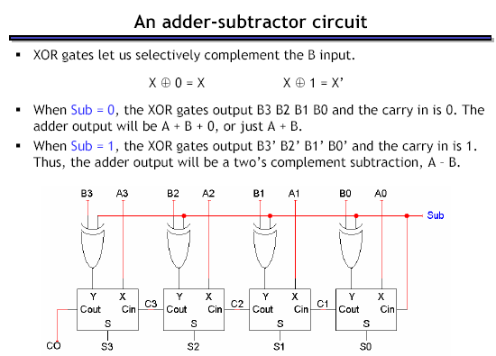
Remember:

Slide 3
Arithmetic-logic units
An arithmetic-logic unit, or ALU, performs many different arithmetic and logic operations. The ALU is the “heart” of a processor—you could say that everything else in the CPU is there to support the ALU.
Here’s the plan:
  We’ll show an arithmetic unit first, by building off ideas from the adder-subtractor circuit.
  Then we’ll talk about logic operations a bit, and build a logic unit.
  Finally, we put these pieces together using multiplexers.
We show the same examples as from the book.

Slide 4
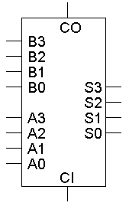
The four-bit adder
The basic four-bit adder always computes S = A + B + CI.
But by changing what goes into the adder inputs A, B and CI, we can change the adder output S.
This is also what we did to build the combined adder-subtractor circuit.

Slide 5
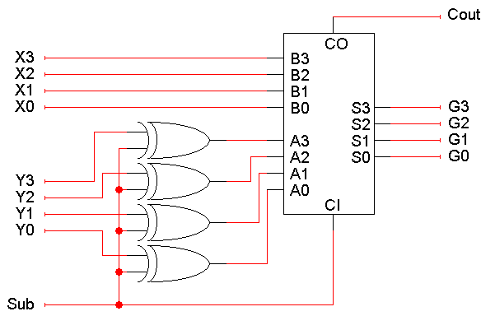
It’s the adder-subtractor again!
Here the signal Sub and some XOR gates alter the adder inputs.
  When Sub = 0, the adder inputs A, B, CI are Y, X, 0, so the adder produces G = X + Y + 0, or just X + Y.
  When Sub = 1, the adder inputs are Y’, X and 1, so the adder output is G = X + Y’ + 1, or the two’s complement operation X - Y.

Slide 6
The multi-talented adder
So we have one adder performing two separate functions.
“Sub” acts like a function select input which determines whether the circuit performs addition or subtraction.
Circuit-wise, all “Sub” does is modify the adder’s inputs A and CI.

Slide 7
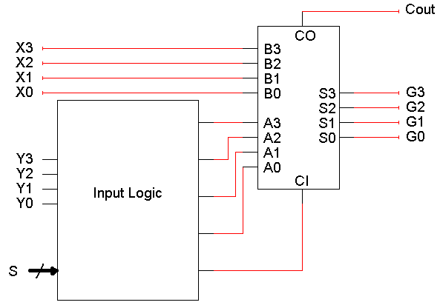
Modifying the adder inputs
By following the same approach, we can use an adder to compute other functions as well.
We just have to figure out which functions we want, and then put the right circuitry into the “Input Logic” box .

Slide 8
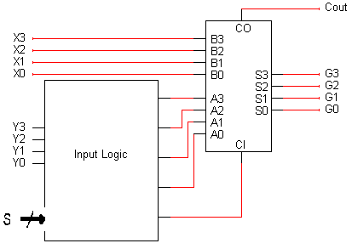
Some more possible functions
We already saw how to set adder inputs A, B and CI to compute either
X + Y or X - Y.
How can we produce the increment function G = X + 1?
How about decrement: G = X - 1?
How about transfer: G = X?
(This can be useful.)
This is almost the same as the
increment function!
One way: Set A = 0000, B = X, and CI = 1
A = 1111 (-1), B = X, CI = 0
A = 0000, B = X, CI = 0

Slide 9
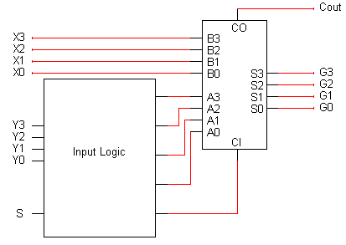
The role of CI
The transfer and increment operations have the same A and B inputs, and differ only in the CI input.
In general we can get additional functions (not all of them useful) by using both CI = 0 and CI = 1.
Another example:
  Two’s-complement subtraction is obtained by setting A = Y’, B = X, and CI = 1, so G = X + Y’ + 1.
  If we keep A = Y’ and B = X, but set CI to 0, we get G = X + Y’. This turns out to be a ones’ complement subtraction operation.

Slide 10
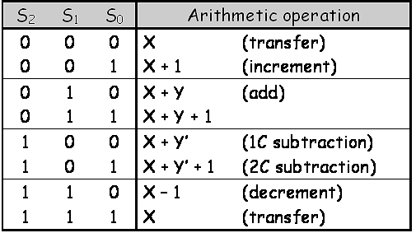
Table of arithmetic functions
Here are some of the different possible arithmetic operations.
We’ll need some way to specify which function we’re interested in, so we’ve randomly assigned a selection code to each operation.
G

Slide 11
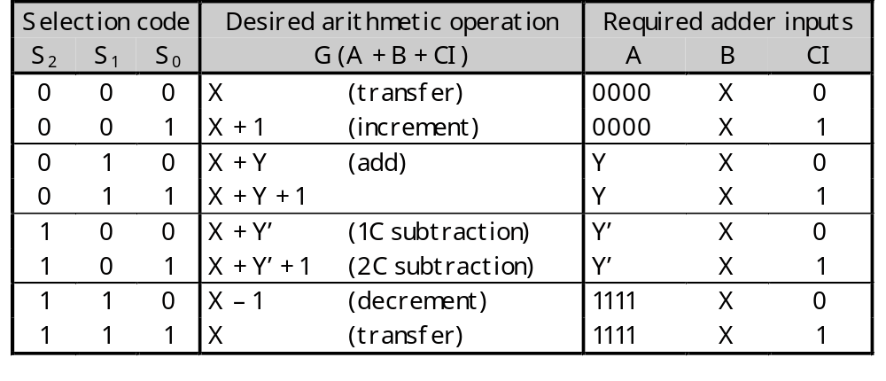
Mapping the table to an adder
This second table shows what the adder’s inputs should be for each of our eight desired arithmetic operations.
  Adder input CI is always the same as selection code bit S₀.
  B is always set to X.
  A depends only on S₂ and S₁.
These equations depend on both the desired operations and the assignment of selection codes.

Slide 12
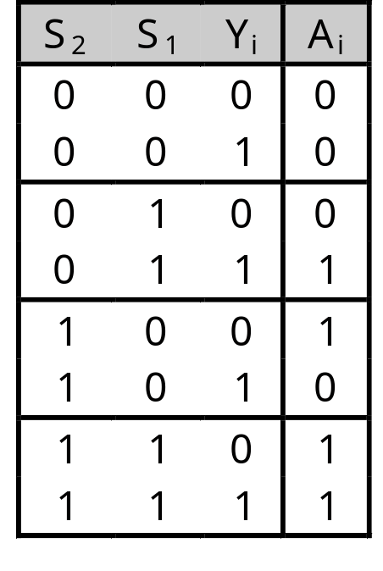
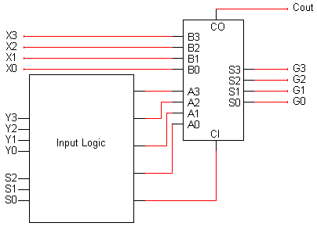
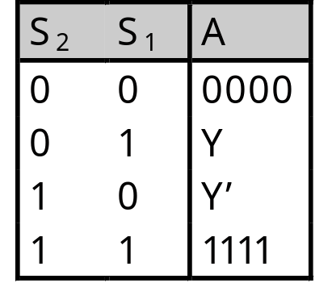
Building the input logic
All we need to do is compute the adder input A, given the arithmetic unit input Y and the function select code S (actually just S₂ and S₁).
Here is an abbreviated truth table:
We want to pick one of these four possible values for A, depending on S₂ and S₁.
inputs
output

Slide 13
Primitive gate-based input logic
We could build this circuit using primitive gates.
If we want to use K-maps for simplification, then we should first expand out the abbreviated truth table.
  The Y that appears in the output column (A) is actually an input.
  We make that explicit in the table on the right.
Remember A and Y are each 4 bits long!
inputs
output

Slide 14
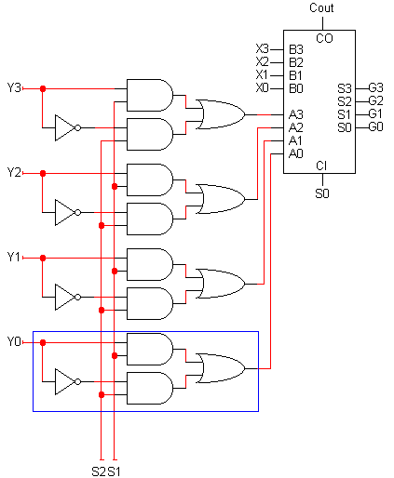
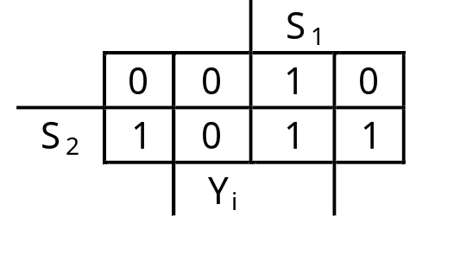
Primitive gate implementation
From the truth table, we can find an MSP:
Again, we have to repeat this once for each bit Y3-Y0, connecting to the adder inputs A3-A0.
This completes our arithmetic unit.
A_{i} = S₂Y_{i}’ + S₁Y_{i}

Slide 15
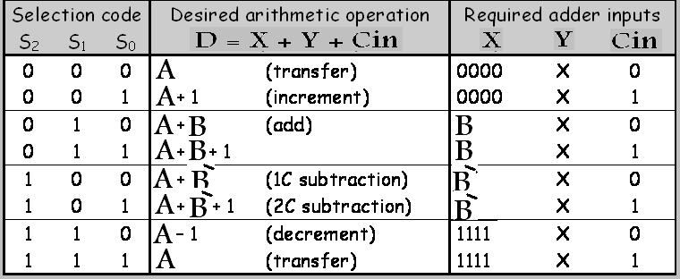

Slide 16
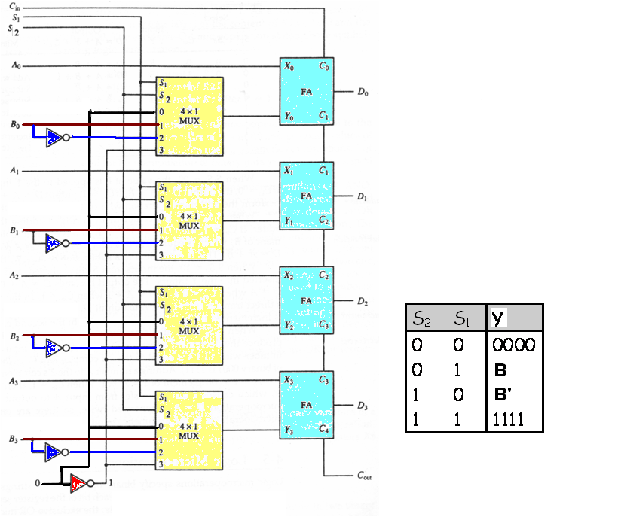

Slide 17
Bitwise operations
Most computers also support logical operations like AND, OR and NOT, but extended to multi-bit words instead of just single bits.
To apply a logical operation to two words X and Y, apply the operation on each pair of bits X_{i} and Y_{i}:
We’ve already seen this informally in two’s-complement arithmetic, when we talked about “complementing” all the bits in a number.
1 0 1 1
AND 1 1 1 0
1 0 1 0
1 0 1 1
OR 1 1 1 0
1 1 1 1
1 0 1 1
XOR 1 1 1 0
0 1 0 1

Slide 18
Bitwise operations in programming
Languages like C, C++ and Java provide bitwise logical operations:
& (AND) | (OR) ^ (XOR) ~ (NOT)
These operations treat each integer as a bunch of individual bits:
13 & 25 = 9 because 01101 & 11001 = 01001
They are not the same as the operators &&, || and !, which treat each integer as a single logical value (0 is false, everything else is true):
13 && 25 = 1 because true && true = true
Bitwise operators are often used in programs to set a bunch of Boolean options, or flags, with one argument.
Easy to represent sets of fixed universe size with bits:
  1: is member, 0 not a member. Unions: OR, Intersections: AND

Slide 19
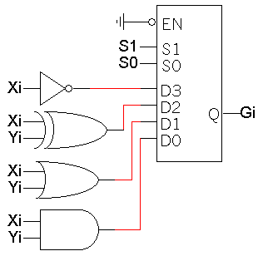
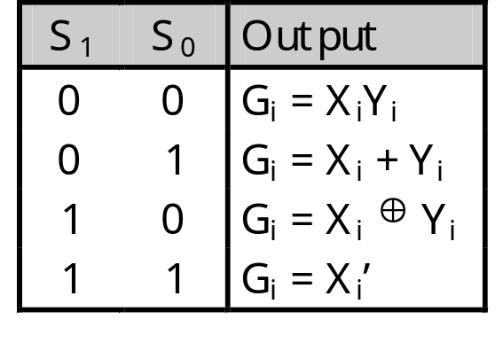
Defining a logic unit
A logic unit supports different logical functions on two multi-bit inputs X and Y, producing an output G.
This abbreviated table shows four possible functions and assigns a selection code S to each.
We’ll just use multiplexers and some primitive gates to implement this.
Again, we need one multiplexer for each bit of X and Y.

Slide 20
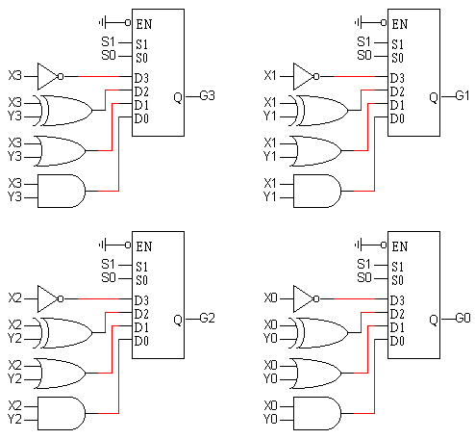
Our simple logic unit
Inputs:
  X (4 bits)
  Y (4 bits)
  S (2 bits)
Outputs:
  G (4 bits)

Slide 21
Combining the arithmetic and logic units
Now we have two pieces of the puzzle:
  An arithmetic unit that can compute eight functions on 4-bit inputs.
  A logic unit that can perform four functions on 4-bit inputs.
We can combine these together into a single circuit, an arithmetic-logic unit (ALU).

Slide 22
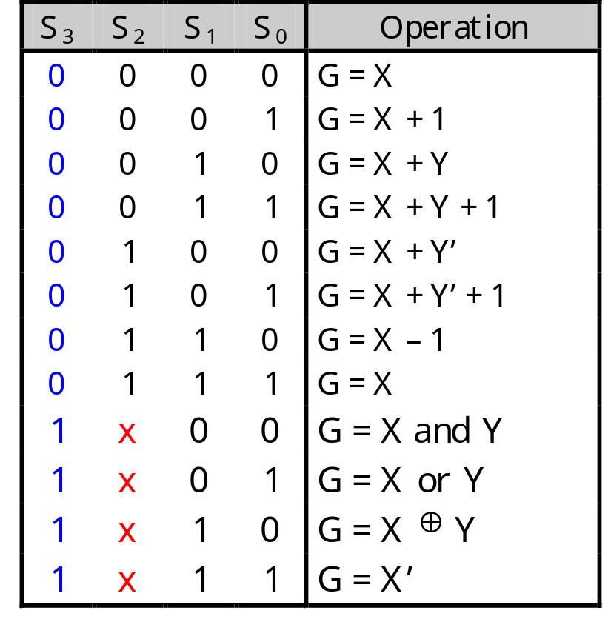
Our ALU function table
This table shows a sample function table for an ALU.
All of the arithmetic operations have S₃=0, and all of the logical operations have S₃=1.
These are the same functions we saw when we built our arithmetic and logic units a few minutes ago.
Since our ALU only has 4 logical operations, we don’t need S₂. The operation done by the logic unit depends only on S₁ and S₀.

Slide 23
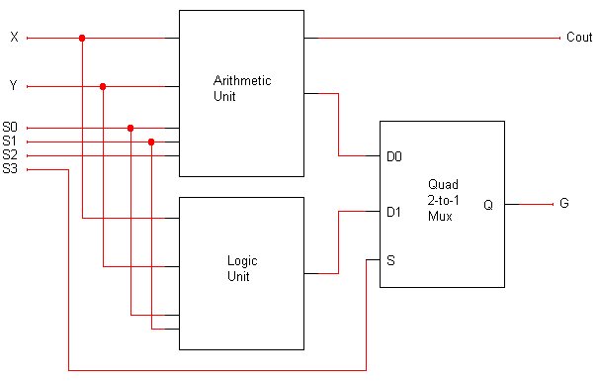
A complete ALU circuit
The / and 4 on a line indicate that it’s actually four lines.
4
4
C_{out} should be ignored when logic operations are performed (when S3=1).
4
4
4
G is the final ALU output.
When S3 = 0, the final output comes from the arithmetic unit.
When S3 = 1, the output comes from the logic unit.
The arithmetic and logic units share the select inputs S1 and S0, but only the arithmetic unit uses S2.

Slide 24
Comments on the multiplexer
Both the arithmetic unit and the logic unit are “active” and produce outputs.
  The mux determines whether the final result comes from the arithmetic or logic unit.
  The output of the other one is effectively ignored.
Our hardware scheme may seem like wasted effort, but it’s not really.
  “Deactivating” one or the other wouldn’t save that much time.
  We have to build hardware for both units anyway, so we might as well run them together.
This is a very common use of multiplexers in logic design.

Slide 25
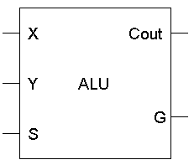
The completed ALU
This ALU is a good example of hierarchical design.
  With the 12 inputs, the truth table would have had 2¹² = 4096 lines. That’s an awful lot of paper.
  Instead, we were able to use components that we’ve seen before to construct the entire circuit from a couple of easy-to-understand components.
As always, we encapsulate the complete circuit in a “black box” so we can reuse it in fancier circuits.
4
4
4
4

